Slide 1
CS 4530: Fundamentals of Software Engineering Module 16: Coding With AI Agents
Adeel Bhutta, Rob Simmons, and Mitch Wand
Khoury College of Computer Sciences
based on material from Jon Bell
© 2026 Released under the CC BY-SA license

Slide 2
This Is Just the Beginning of Our Conversation
This topic is unlike anything covered so far:
The technology is evolving faster than any textbook can capture
There is genuine disagreement among experts about best practices
The hype is real—and so are the concerns
Your professors are learning alongside you, modeling the best practices we teach

Slide 3
Disclaimer
I do not claim to be an expert on this subject
Much credit to Prof. Jon Bell and the CS 3100 team, on which this lecture is based.
I also had extensive conversations with claude.ai, who made good suggestions about restructuring the section on prompting. I'll credit these when we get to them.
Notes:
So we start off here with an ethical problem: how do you credit an AI, when the AI made substantial contributions to the work?

Slide 4
Learning Goals for this Lesson
By the end of this lesson, you should be able to
Explain what an AI Coding Assistant is and is not
Describe how to determine when using an AI assistant is or is not appropriate
Explain the 6-step Human-AI Workflow pattern
Explain the Plan-First pattern
Explain the Prompt-Contract pattern
Know how to avoid de-skilling
Notes:
<read slide>

Slide 5
Outline
What is an LLM? What is an AI Coding Assistant? Why is context so important?
A 6-step Pattern for Human-AI Workflow
Patterns and Myths for Effective Prompting
A few words about AI traps

Slide 6
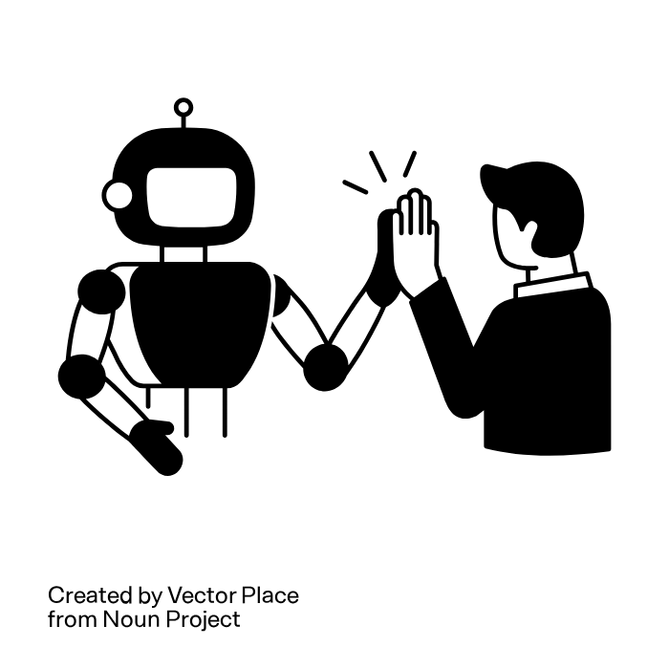
Our Slogan:
AI amplifies human capabilities; it doesn't replace them
https://thenounproject.com/browse/icons/term/ai-collaboration (CC BY 3.0)

Slide 7
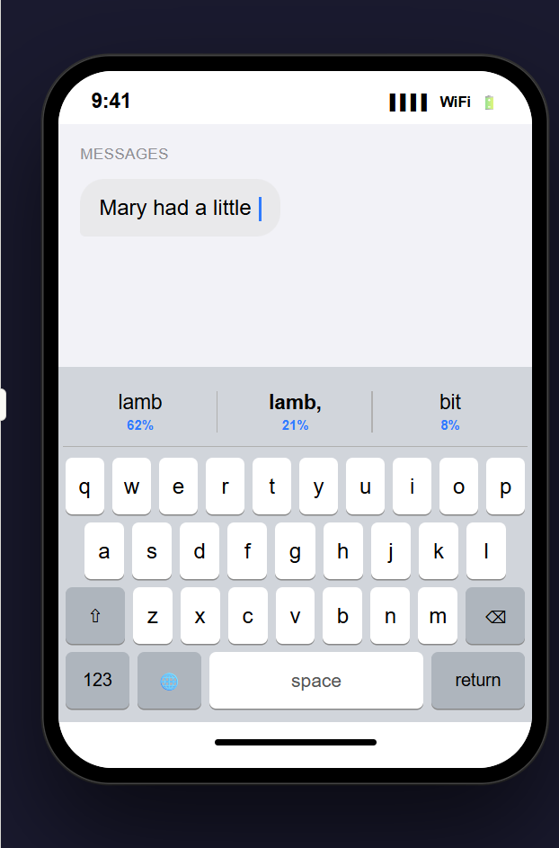
1. What is a Large Language Model (LLM?)
Basically, it is an overgrown autocomplete.
Given a large database of texts and an initial segment of your input, it answers the question:
What is the most likely way in which this input would continue?
More accurately: it produces a probability distribution of likely continuations, and draws from that distribution (hence non-deterministic)
Notes:
Here the autocorrect shows its guess about the next word <click> Observe that it has also assigned probabilities to each of the alternatives.

Slide 8
Why this matters
Explains hallucination: model predicts plausible-looking text, not necessarily true text
Explains why context matters: predictions depend on what came before
Explains strengths: patterns in code are highly predictable!

Slide 9
What is an AI Coding Assistant?
An AI coding assistant typically consists of an LLM
trained on a large base of running code
operating in a loop with an IDE
it can add artifacts inside the IDE to its context
it can operate on your code (with your permission)

Slide 10
AI Coding Assistants: Strengths
Strengths:
Pattern recognition: recognizes and reproduces common coding patterns across millions of codebases
Syntax knowledge: extensive knowledge of languages, libraries, and frameworks
Cross-domain transfer: can apply patterns from one language to another
Rapid prototyping: generates boilerplate, tests, and common implementations quickly
AI in-the-loop: can run tests and evaluate the results
did it work? if not it can try something else

Slide 11
AI Coding Assistants: Limitations
Limitations:
Context window: can only see ~100K tokens at once — may miss parts of large codebases
Generates code based on patterns, not execution results
Hallucination: may generate plausible-looking code that doesn’t actually work, or doesn't satisfy your project constraints.
Think of it as a well-read junior developer who has seen millions of codebases — but has never run your specific project.

Slide 12
Context Is Everything
Rich context → High-quality output
Why IDE integration matters:
Copilot sees your open files → more context
Claude Code reads your whole codebase → even more context
More relevant context = better predictions

Slide 13
The Secret Sauce: Static Analysis Powers Context
How AI coding assistants automatically find the right context:
AST parsing: understands code structure, not just text
Semantic indexing: knows what symbols mean, where they’re defined
Call graphs: traces which functions call which
Type information: knows the types flowing through your code
When your cursor is in a method, the tool KNOWS the class you’re in, the interfaces it implements, the types of parameters, and available methods — and sends EXACTLY this to the LLM, not your whole codebase.

Slide 14
Static Analysis Can't Find Everything
What tools can auto-find: related files, type definitions, call graphs, similar patterns, test files
What tools cannot auto-find: why a design was chosen, undocumented requirements, knowledge in your head
This is why DESIGN.md and documentation matter — it’s context the tool CAN find.

Slide 15
2. A 6-Step Human-AI Collaboration Workflow
Identify — recognize what information AI needs
Engage — craft effective prompts with context
Evaluate — critically assess AI outputs against your success criteria
Calibrate — steer AI toward desired outcomes through feedback
Tweak — manually refine generated artifacts
Finalize — document decisions and rationale
Based on Google research studying 21 expert developers working with AI
This is not a rigid sequence — steps may overlap and you will often loop back.

Slide 16
Identify and Engage: what information does the AI need?
What are the domain concepts?
What level of detail is needed for the initial domain model?
What requirements information should be captured (user stories, functional requirements, non-functional requirements)?
What design artifacts would be useful for us to generate and maintain?

Slide 17
How much context you need to provide depends on three things:
Your understanding: Experts know exactly what context matters; novices may not know what to include. You can only identify relevant context for things you understand.
Model capabilities: Frontier models infer much more from less. GPT-3.5 needed explicit instructions; Claude Opus can often infer intent.
Tool capabilities: Basic Copilot sees only your open files. Cursor and Claude Code index your entire codebase and find files automatically.
When all three are HIGH: just describe intent — the system figures out context. When any is LOW: you must compensate manually

Slide 18
Step 2: Engage
Craft effective prompts at multiple levels
This is a complicated topic
Nobody really knows…
But we'll give you an outline later in the lecture

Slide 19
Step 3: Evaluate: critically assess AI outputs against your success criteria
The Plan-First pattern
How do you know you're done?

Slide 20
The Plan-First Pattern, Part 1
Have the AI generate a PLAN first; generate code only after plan passes review.
A plan has a small evaluation surface (easier to review)
Expert review: “Wait, we should use sessions not JWT for this use case”
plan exposes architectural issues early.
Learner review: “I don’t know what JWT is — I should learn that before approving!”
plan reveals knowledge gaps.
Cost to fix at this stage: LOW
If you can’t evaluate the PLAN, you can’t evaluate the CODE. Plans reveal knowledge gaps early.

Slide 21
The Plan-First Pattern, Part 2: Verify that the code matches the blueprint
After plan approval, AI generates code. Review code WITH the plan as a checklist.
“I know what to look for because I already approved the approach.”
If you can’t evaluate the PLAN, you can’t evaluate the CODE. Plans reveal knowledge gaps early.
Advanced usage: some of this review can be automated (with a separate, isolated AI)
But then you still have to review the review!

Slide 22
You also need a plan to evaluate the plan (and the code)
Assess AI outputs against expected results utilizing domain knowledge.
Compare output against expected end results and other success criteria.

Slide 23
How Do You Know You’re Done?
Whether waterfall or agile, you need to know what “done” means BEFORE you start each piece of work.
Without a definition of done:
“Make it better” — but better how? Better for whom?
Endless tweaking with no exit condition
“I’ll know it when I see it” rarely works in practice
With a definition of done:
Clear success criteria BEFORE you start prompting (or coding)
Each output can be checked against the criteria
The plan you approved in Plan Mode IS your definition of done
Remember: user stories, conditions of satisfaction, etc.

Slide 24
If you can't evaluate the AI output, maybe you shouldn't be using so much AI
Easy to evaluate — use AI freely:
Does the script run? Does it compile? Does the test pass? (binary yes/no — verify immediately)
Hard to evaluate — use AI carefully:
Does the quiz have confusing questions? → Give it to 100 students and find out
Is this architecture scalable? → Wait 6 months in production
Will users find this intuitive? → Ship and measure
AI can help you GENERATE for any task. But for hard-to-evaluate outcomes, don’t rely on AI to EVALUATE — you need external validation: user testing, expert review, time in production.
Notes:
This is a good point to reconsider whether AI is the right tool for the job.

Slide 25
Steps 4-6: Calibrate/Tweak/Finalize
Calibrate: Steer AI toward desired outcomes through feedback
Example: “That’s close, but use interfaces instead of abstract classes”
This is a conversation — you may calibrate 3–4 times per task. This is normal.
Tweak: Manually refine AI-generated artifacts
Naming, edge cases, comments, style adjustments. AI output is rarely perfect — this is expected.
Finalize: Document decisions and rationale
Create artifacts to guide future development
Notes:
<read slide>
Let's look at each of these in a little more detail.

Slide 26
Steps 4 and 5: Calibration and Tweaking
Especially applicable for non-code AI-generated artifacts
text
diagrams
slides
etc…
Notes:
Prof Wand says: Large portions of this slide deck were generated by Claude from the 3100 slides, which were in a Markdown dialect. Claude produced some slides, but they were in an entirely different design style. I then had to calibrate by giving Claude a sample of the slides we were using for this course, and Claude re-did the slides to match our style.
But the results were still far from perfect, and I spent a lot of time tweaking things-- splitting too-long bulleted lists into multiple slides, etc.
And this deck is the result of merging the Claude results with the similar slides I prepared for Fall 2025.
And also it incorporates more thinking about the subject, along with good new material I found on the web.
REMEMBER: THE HUMAN MAKES THE FINAL DECISION

Slide 27
Step 6: Finalizing
Before committing AI-generated code, ask yourself:
Can I justify the design decisions in this code to a colleague?
If I look at this in 6 months, will I know WHY I chose this approach?
Am I prepared to take responsibility if this code is wrong?
Would a new team member understand the design decisions?
If the answer to any of these is “no” — you are creating maintenance debt that future-you will pay.
“It worked” is not a reason. “The AI suggested it” is not a reason. Document the actual design rationale.

Slide 28
Use Design As a Way of Communicating Organization
Remember this slide from Module 08 Code Level Design?
Software systems must be comprehensible by humans
Which humans?
The other members of your team
The folks who will maintain and modify your system
Management
Your clients
and ...
You, a week from now or 6 weeks from now

Slide 29
What an AI can't do (or do well)
Architecture/Design
if you tell it the architecture, the AI can build it
but the AI can't decide on the design
Debugging (!!!!)
Ais are trained on working code, so their debugging skills are often not very good (but this may change).
Maintenance
I don't think we have much info on this yet

Slide 30
When should I use AI? Task familiarity determines appropriateness
Use AI when: You have sufficient domain knowledge to evaluate outputs
Avoid AI when: You lack the expertise to assess correctness and quality
Learning consideration: Using AI without foundational knowledge can lead to deskilling

Slide 31
Back to step 2: Engage: Craft Effective Prompts at all Levels
We'll look at different roles that prompts can play in an AI workflow
We'll discuss the Contract-Prompt pattern
We'll list some myths (and non-myths) about prompting.

Slide 32
There are at least 4 levels of prompting with your AI
Layer | File | Scope | Who reads it
Project constraints | CLAUDE.md | Whole project, persistent | Auto-read every session
Architecture/rationale | DESIGN.md, README.md | Whole project, reference | Indexed and retrieved by context
Task prompts | .claude/commands/*.md | Per-task, reusable | Invoked explicitly via slash command
In-chat prompt | typed in session | One-off, ephemeral | Only the current session
You can see there is some Claude-specific info here; we'll talk about other agents later
Table generated by Claude.ai
Notes:
Project constraints: generally set in advance. May differ for different modules (front end, back end, etc.)
Architecture/Rationale: portions set in advance (eg project/directory structure), some recorded at end of project (Step 6: Finalize) for future development
You'll see there is some Claude-specific stuff here; we'll talk about other agents later
And here's a spot where I need to give credit to Claude AI, which suggested this analysis of the 4 levels.

Slide 33
Layer 1: Project Constraint Prompts
These are your guardrails
## Software Stack
- Frontend: Next.js 14+ App Router, TypeScript strict
- Backend: Convex for real-time data, Supabase for auth + storage
- Auth: Clerk (never roll custom auth, we are not animals)
- Styling: Tailwind only — no CSS modules, no styled-components
## Hard Rules
- Never install a new dependency without asking first
- Never modify the database schema without showing the migration plan
- All API calls go through Convex functions, never direct Supabase
client calls from components
- Environment variables go in .env.local, never hardcoded
(I will find you and I will revert you)
# FAILURE CONDITIONS:
- Any component exceeds 150 lines
- Fetches data client-side when it could be server-side
- Uses any UI library besides Tailwind utility classes
- Missing loading and error states
- Missing TypeScript types on any function parameter
Notes:
Of course, this pattern applies to other agents as well.

Slide 34
Layer 2: Architecture/Rationale Prompts
## Repository Structure
- `src/` for source code
- `additionService.ts` for business logic
- `additionController.ts` for handling requests
- `*.test.ts` for tests
- `scratchpad.ts` for experimental code
- `express.ts` for express app setup
- - `src/server.ts` to start the application
`package.json` for dependencies and scripts
## Patterns
- Use server components by default, client components only when
interactivity is required
- Error boundaries on every route segment
- Zod validation on every user input
Autogenerated README.md files can be a good basis for this portion of the prompt
Notes:
(These are from two different projects). Many of our repos have exhaustive README's. (Prof. Wand says: some of them are very good, others not so good, I(HIS)HO.) I.f you guess they were generated by AI from the codebase, you are probably right. But if you use one of them, make sure it reflects what YOU want in YOUR project.

Slide 35
Layer 3: Task Prompts
Carefully craft these in advance
Put each of them in a file so they can be reused, eg
.claude/commands/add-subscription.md
Notes:
Again, this file location is specific to Claude.

Slide 36
For Task Prompts, use the Contract-Prompt pattern
Write prompts like like legal contracts, with four enforceable sections:
Goal — the exact success metric.
Output Format — the specific structure you expect.
Constraints — hard boundaries that can’t be crossed.
Failure Conditions — what makes the output unacceptable.
Include these if the weren't covered in Layers 1 and 2
Phil Rentier, "I Stopped Vibe Coding and Started “Prompt Contracts” — Claude Code Went From Gambling to Shipping" in Medium.com, Feb. 11, 2026
Notes:
This makes "When you're done" readable to your AI.

Slide 37
Task Prompt Section 1: Goal
# Goal (Before: vibe) Add a subscription system to the app
- Add a subscription system to the app
# Goal (After) Implement Stripe subscription management
## Success
- a user can subscribe to one of 3 tiers (free/pro/team)
- a user can upgrade/downgrade instantly
- a user can see billing status on /settings/billings
- a free user can subscribe to Pro,
- see the charge on Stripe dashboard
- access gated features within 5 seconds.
The difference is testability -- each of these can be independently tested.
Notes:
The author (Phil Rentier) writes: "[the original prompt] is the prompt equivalent of telling your GPS “take me somewhere nice.” You’ll end up somewhere. It might be a Michelin star restaurant. It might be a gas station in Ohio.
Notice the user-story/COS framework here.

Slide 38
Task Prompt Section 2: Format
What you want delivered, and how you want it delivered
Tell it what to hand you
Before:
After:
Create an API endpoint for user onboarding
# FORMAT:
1. Convex function in convex/users.ts (mutation, not action)
2. Zod schema for input validation in convex/schemas/onboarding.ts
3. TypeScript types exported from convex/types/user.ts
4. Include JSDoc on the public function
5. Return { success: boolean, userId: string, error?: string }

Slide 39
Mapping the layers to other AI Agents
Most tools have converged on at least two layers of prompts--
Here are some tables to illustrate:

Slide 40
Layer 1: Project Constraints (persistent, auto-loaded)
Tool | File Location | Notes
Claude Code | CLAUDE.md (repo root) | Auto-read every session; supports nested files in subdirectories
GitHub Copilot | .github/copilot-instructions.md | Auto-attached to all chat requests; AGENTS.md also works and is more portable across tools
Cursor | .cursor/rules/*.mdc | Supports path-specific rules per subdirectory; old .cursorrules still works but deprecated
ChatGPT | Project custom instructions (UI only) | Set in the ChatGPT interface — not a repo file, not version-controlled
Table generated by Claude.ai

Slide 41
Layer 2: Task Prompts (invoked explicitly per task)
Tool | File Location | How to Invoke
Claude Code | .claude/commands/*.md | Type /filename in chat
GitHub Copilot | .github/prompts/*.prompt.md | Type /promptName in VS Code, #promptName in Visual Studio
Cursor | .cursor/rules/*.mdc (with alwaysApply: false) | Agent picks up relevant rules automatically, or reference with @rulename
ChatGPT | No repo-file equivalent | Paste manually, or upload as a file to the Project
Table generated by Claude.ai

Slide 42
Prompting Myths That Don’t Actually Help
Myth: Persona prompts improve output
“You are a brilliant 10x engineer...” — Models don’t roleplay better code. Context and specificity matter, not flattery.
Myth: Politeness affects performance
“Please” and “Thank you” — Won’t affect the model, but polite communication is a good habit for talking to humans!
Myth: More instructions = better
500-word system prompts often perform WORSE — key details get lost. Be concise and specific.
Myth: Magic phrases always work
“Think step by step” — Useful for reasoning, but tools have built this in better. See: Plan Mode.
What actually helps: Relevant context · Specific requirements · Concrete examples · Clear success criteria

Slide 43
Making sure the AI obeys the constraints
When you start a new session, always say:
In fact, say this (or the equivalent) every so often
Makes sure that the project constraints haven't drifted out of the context
On startup, this asks the agent to expose ambiguities, etc., when they are easier to fix.
- Read CLAUDE.md and confirm you understand the project constraints before doing anything.
Notes:
Claude (and most other agents) have shortcut commands for this. (Prof. Wand says: my son, who has worked a lot in this area, says he starts *every* prompt with a shortcut for this.)

Slide 44
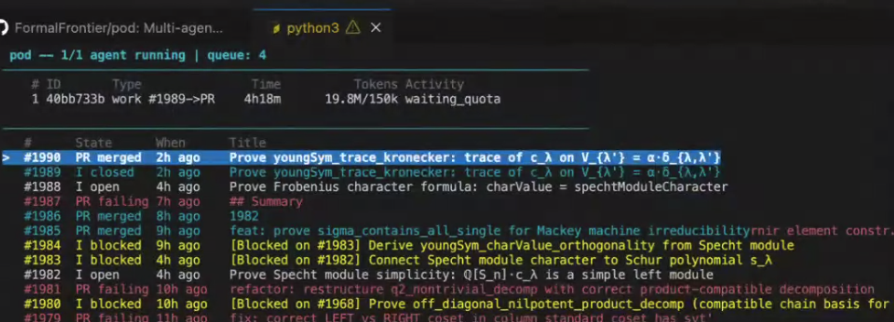
“Teams of agents”
So far in 2026, there have been some unhinged, heavily hyped versions of having different agents with different instructions working together. (Search for “Gas Town Yegge” at your own risk)
One of Prof Simmons’s colleagues at Lean FRO, Kim Morrison, recently demoed a less unhinged version of this idea, shown here.
Notes:
Just like you have different team members with different skills, recently a lot of attention has been given to making teams of AI agents that are given specific role-playing instructions: “you’re in charge of keeping everyone on task,” “you’re in charge of reviewing PRs for frontend engineering,” “you are here to do one specific task described in this pull request and then go away forever” (Mr. Meeseeks is the appropriate Rick and Morty reference if you’re so inclined)
This is a screenshot that Prof. Simmons saw on Monday. It’s a log of a python script — written primarily with Claude — showing the workflow by which dozens of Claude agents are collaborating by filing GitHub issues and closing them with PRs, which other agents are closing.
Nobody at present thinks this kind of workflow produces good software engineering — software maintainable over time — but it is demonstrably better at doing certain goal-oriented complex tasks (like searching for bugs in a compiler).
(It can be emotionally exhausting to argue with an AI agent, but AI agents don’t experience emotional exhaustion and can yell at each other)

Slide 45
4. A few words about AI traps

Slide 46
Trap #1: The “Vibe Coding” Trap
What is “vibe coding”?
Evaluating only EXECUTION, not CODE. Ask AI to implement a feature. Run the app, see if it “works.” If error, describe the error to AI and repeat. Never actually read or understand the code.
Why it leads to collapse:
No troubleshooting capability — you don’t understand what the code does
Can’t provide effective feedback — you can only describe symptoms, not problems
Brittle development — one change breaks everything and you don’t know why
To effectively use AI, you must be able to EVALUATE the code itself — not just “does it run?”

Slide 47
Trap #2: AI Creates “Learning Debt” When Used Too Early
Path A — Learning First (recommended):
Manual coding, mistakes, understanding errors, building mental models. Slower at first.
When you eventually use AI, you can evaluate and guide it effectively.
Solid foundation that supports long-term productivity growth.
Path B — AI First:
Fast initial progress. But you never learn WHY the code works.
When complex bugs hit, you’re stuck — you can’t even describe the problem to AI effectively.
Productivity collapses and never recovers to Path A levels.

Slide 48
A "learning-tax" strategy can help mitigate deskilling.
Adopt a “learning tax” strategy: deliberately choose to implement certain components manually, even when AI could generate them instantly.
Otherwise you won't recognize when the AI is screwing up!
The goal isn’t to code without AI or to use it for everything, but to maintain the expertise that makes you irreplaceable—the judgment, creativity, and deep understanding that transforms good code into great software. (--Jon Bell)

Slide 49
Outline
What is an LLM? What is an AI Coding Assistant? Why is context so important?
A 6-step Pattern for Human-AI Workflow
Patterns and Myths for Effective Prompting
A few words about AI traps
Notes:
OK, we've covered a *lot* of material in this lecture. Let's look once more at the outline to see where we've been.

Slide 50
Learning Goals for this Lesson
Now, at the end of this lesson, you should be able to
Explain what an AI Coding Assistant is and is not
Describe how to determine when using an AI assistant is or is not appropriate
Explain the 6-step Human-AI Workflow pattern
Explain the Plan-First pattern
Explain the Prompt-Contract pattern
Know how to avoid de-skilling
Notes:
And here are some learning goals, because we always write learning goals.
<read slide>
I hope this has been valuable for you!

